Slide 1

Team- Bajrangi Bhaijaans
Shaam
Saatvika
Harshini
Cheshta
Breathe | In | Opportunity

Slide 2
Problem Statement
Environmental contamination due to improper waste disposal is a global issue. (Ferronato and Torretta, 2019).
Unplanned waste dumping and accumulation has lead to increasing air, water and soil pollution.
The working population do not obey the timely waste collection done by the municipalities.
During the lockdown the residential segment generated more waste compared to the industrial and commercial centres as they were completely shut (“Waste Management Market | Trends, Growth, Forecast (2020-2027),” n.d.).
There is no timely collection of household waste by municipalities due to the lockdown (Sarkodie and Owusu, 2020).
The citizen’s participation is required to ensure proper waste disposal process would make it more efficient and manageable
Breathe | In | Opportunity

Slide 3
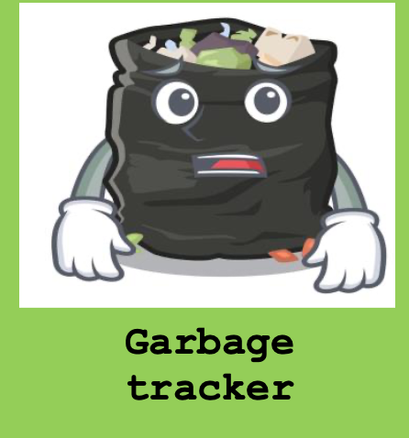
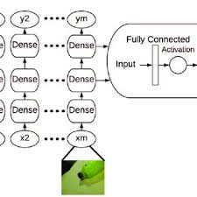
Idea/Solution Description
To solve this issue we are coming up with an app, using convolutional neural network.
App name- Garbage tracker
Main Feature- Helps people to maintain their locality clean by updating the municipality about waste accumulated or open/overflowing manholes
Accuracy – 97%
Breathe | In | Opportunity

Slide 4
Working
This app serves as a bridge between waste management system and citizen.
It has inbuilt GPS 8 for analysing the location of the area.
When a common citizen finds that waste accumulated or overflowing of manholes, he/she can use this app to scan and analyse the trash.
A message as well the notification will be sent to near by municipality cleaner regarding the related issues.
The update then has to be claimed by the municipal corporation or the private waste management facilities.
Through this we can ensure proper disposal of waste

Slide 5
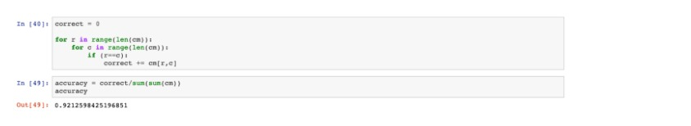
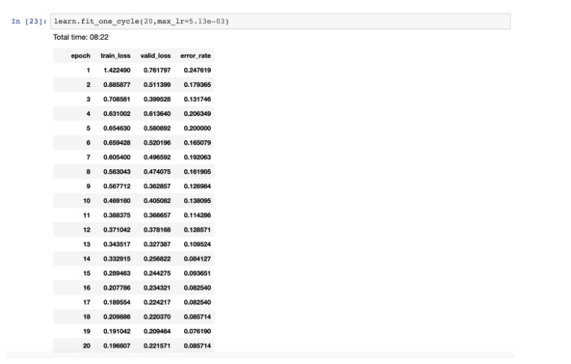
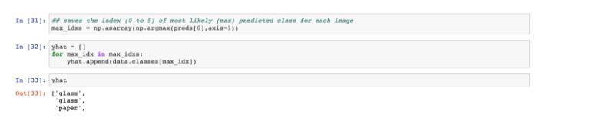
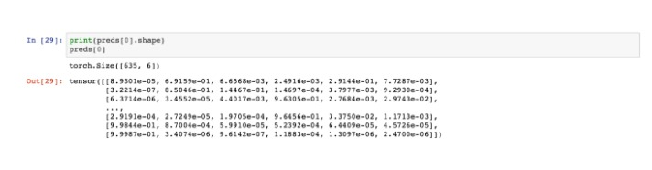
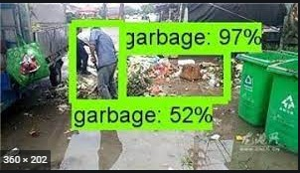

Slide 6
USP
Taking the existing technology to a step higher, use of convolutional neural network
The pictures will be linked with IP address to help locate the exact location
The rag pickers in the area will get a better source of income as they will be directed to clear the waste and report to the municipality
It reduces pressure on the municipality corporation to maintain a track of all the waste accumulation prone areas.
It also helps small waste management centers to increase their business and increase the employees.
It is AI based which reduces the chances of human error
Breathe | In | Opportunity

Slide 7
Market Research
Market demand-
There are is growing number of activists movement among the masses. This has led to increased sensitisation among the public who want to take up initiatives to actively participate in the waste management process.
India’s smartphone base is estimated to reach 820 million in the next two years (Singh, 2013). So, a large proportion of the population can access this app and use it
Breathe | In | Opportunity

Slide 8
Existent players in the field of waste management
App | Features
Waste Management App | Waste payment app Access local information and policies on waste management Monitor and track waste pickups
IRecycle | Locate the nearest recycle centres in their vicinity. Teaches users the different DIY ways to recycle wastes.
My Waste | Partners with municipalities all over the world to provide its users up-to-date waste management and recycling news Identify recyclable wastes as well as locate recycling centres closest to them.
Gimme 5 | Helps users identify the right recyclable plastics
Yo-waste | Helps to ensure regular waste collection from household, rate the collection, request extra pick-ups from households.

Slide 9
Technological Stack
The Tech stack
Java
Kotlin
Neural Networks
Open CV
Image Processing
Breathe | In | Opportunity

Slide 10
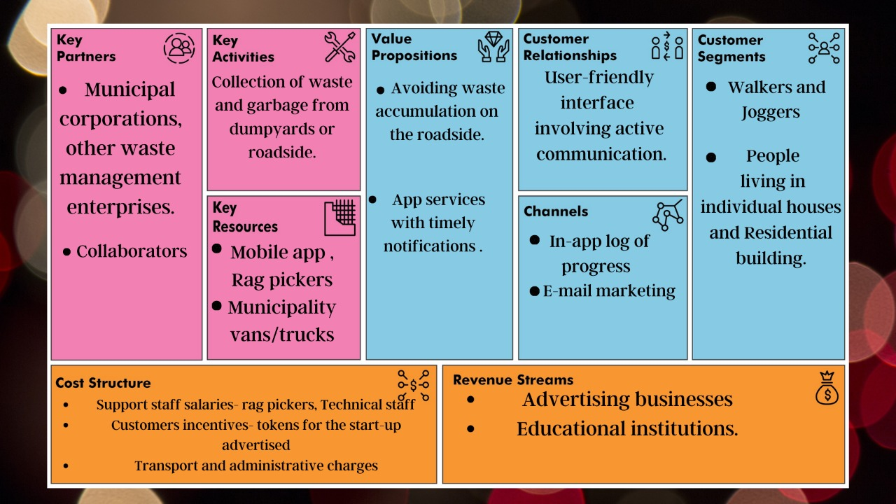
BMC
Breathe | In | Opportunity

Slide 11
Future Prospects
There will be few volunteers deployed in some areas who will bring about awareness about the app to increase its user base.
We aim to get more and more small waste management facilities to tie up with us
We can include well known activists as one of our board members who will provide with better direction and add to the credibility of the app.
We aim to add sensors to further analyse the kind of waste that is present in the scan so that the municipality gets a better perspective to deal with it
Breathe | In | Opportunity

Slide 12
References
Sarkodie, S.A. and Owusu, P.A., 2021. Impact of COVID-19 pandemic on waste management. Environment, development and sustainability, 23(5), pp.7951-7960.
Singh, P., 2013. Smartphones are keeping users in India plugged in. Nielsen Informate Global Insights.
Ferronato, N. and Torretta, V., 2019. Waste mismanagement in developing countries: A review of global issues. International journal of environmental research and public health, 16(6), p.1060.
Waste Management Market | Trends, Growth, Forecast (2020-2027) [WWW Document], n.d. URL https://www.astuteanalytica.com/industry-report/waste-management-market (accessed 5.3.21).
You, S., Sonne, C. and Ok, Y.S., 2020. COVID-19's unsustainable waste management. Science, 368(6498), p.1438.
Ramachandra, T.V., Bharath, H.A., Kulkarni, G. and Han, S.S., 2018. Municipal solid waste: Generation, composition and GHG emissions in Bangalore, India. Renewable and Sustainable Energy Reviews, 82, pp.1122-1136.
Marfe, G. and Di Stefano, C. eds., 2020. Risks and Challenges of Hazardous Waste Management: Reviews and Case Studies. Bentham Science Publishers.

